Slide 1
Neural Efficiency for LAM/LLM
May 17, 2023

Slide 2
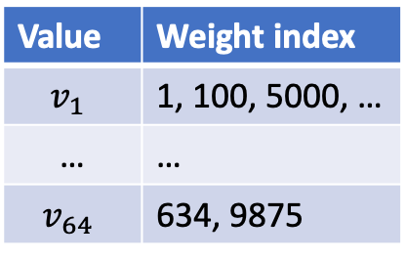
Quick Overview of our Hardware Acceleration Effort
What does it mean by “efficiency”?
Computation: to run inference faster
GPU Memory: to store the model instances
Bandwidth: to transfer data into GPU
Value | Weight index
$$v_{1}$$ | 1, 100, 5000, …
… | …
$$v_{64}$$ | 634, 9875
Weights are mapped into
1 of 64 values
GPU Memory
(Weights)
System Memory
(Data)
GPU Computation Core

Slide 3
Quick Overview of our Hardware Acceleration Effort
What are the constraints for LAM/LLM?
Via some rough calculations, LAM/LLM seems to be constrained mainly by GPU memory
(With CPU decoding, computation is the main constraint .)
ChatGPT 175B params * 16bit = 350GB, text only 1B params * 16bit = 2GB
 | Model Num Params (B) | Model Memory (GB) | GPU Memory (GB) | Speed (teraFLOPS) | GPU bandwidth (GBps) | Number of Max Supportable Models | Min Latency due to Computation | Min Latency due to Bandwidth
8x Nvidia A100 GPU | 175 | 350 | 8*80 | 8*312 | 2039 | 1 | < 0.1ms (175/(8*312)) | < 0.01ms (12288*96*96*2/(2039*10^9))
G5.24xlarge | 1 | 2 | 96 | 4*125 | 600 | 33 (~4*125/15) | RescoreBERT < 0.1ms (33*1/(4*125*10^3)) 1B Conformer - 3ms (50*33*1/(4*125*10^3)) for 50 frames - 48s if using G5 CPUs (33*50*1/96*2.8) | RescoreBERT < 0.01ms 1B Conformer - 3ms (33*50*4096*17*8*2)/(600*10^9)

Slide 4
Quick Overview of our Hardware Acceleration Effort
Technologies to improve each aspect
 | Applicable | Memory Reduction | Computation Reduction | Bandwidth Reduction
Quantization | All layers | 50% (16bit → 8bit) | 50% (16bit → 8bit) | 50% (16bit → 8bit)
Sparsification | All layers | 50% (50% sparse) | 50% (50% sparse) | -
Sub-8-bit compression | All layers | 50% (8bit → 4bit) | 50% (8bit → 4bit) | -
Arbitrator, turning layers on and off | All layers | - | 50% | -
Low rank approximation | Attention | No info | No info | -
Weight sharing | All layers | 50% (2 layers share 1) | - | -
Compression for LAM-LLM embedding interface | Embedding, interface | 75% (32bit → 8bit) | - | 75% (32bit → 8bit)

Slide 5
Quick Overview of our Hardware Acceleration Effort
Technologies to improve each aspect
Computation
Memory
Arbitrator
Quantization
Weight sharing
Sparsification
Low rank for Attention
Compression for LAM/LLM interface
Sub-8-bit compression

Slide 6
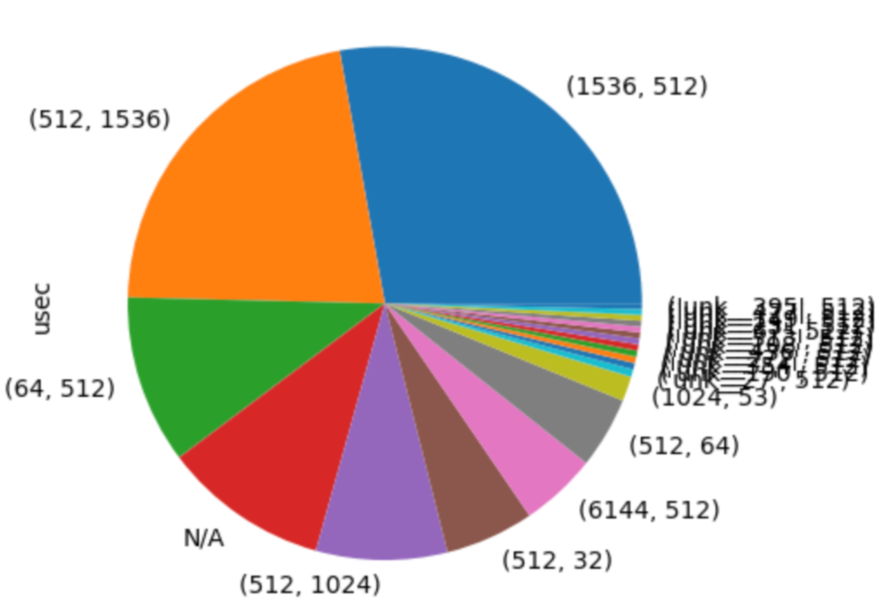
Quick Overview of our Hardware Acceleration Effort
Technologies to improve each aspect
Side note: Attention contributes only to 10% of the latency
Attention
Values
Attention
Keys/Queries

Slide 7
Quick Overview of our Hardware Acceleration Plan
Priority for 2023 – Technologies Applicable to All Layers
Quantization
Conformer – prod Conformer, next step 1B
RescoreBERT – kickstarted together with Denis, presented later
Sparsification
Conformer – NemoRT support needed
RescoreBERT – good results obtained, presented later
Embedding
8-bit quantization and sub-8-bit compression – on-hold as lacking HC

Slide 8
Quick Overview of our Hardware Acceleration Plan
Tentative Plan for 2024 – Technologies to Address Memory Constraint
Sub-8-bit weight
Weight sharing for LAM/RescoreBERT layers
Arbitrator turning layers on and off
Low-rank approximation of attention
Quantization Aware Finetuning (QAF)
LayerDrop and Distill

Slide 9
Quick Overview of our Hardware Acceleration Plan
Priority for 2023 – Technologies Applicable to All Layers
Quantization
Conformer – prod Conformer, next step 1B
Aachen team: Jahn Heymann, Abhishek Sharma
NeMoRT team: Chris Beauchene
RescoreBERT – kickstarted together with Denis, presented later
Sparsification
Conformer – NemoRT support needed
RescoreBERT – good results obtained, presented later
Embedding
8-bit quantization and sub-8-bit compression – on-hold as lacking HC

Slide 10
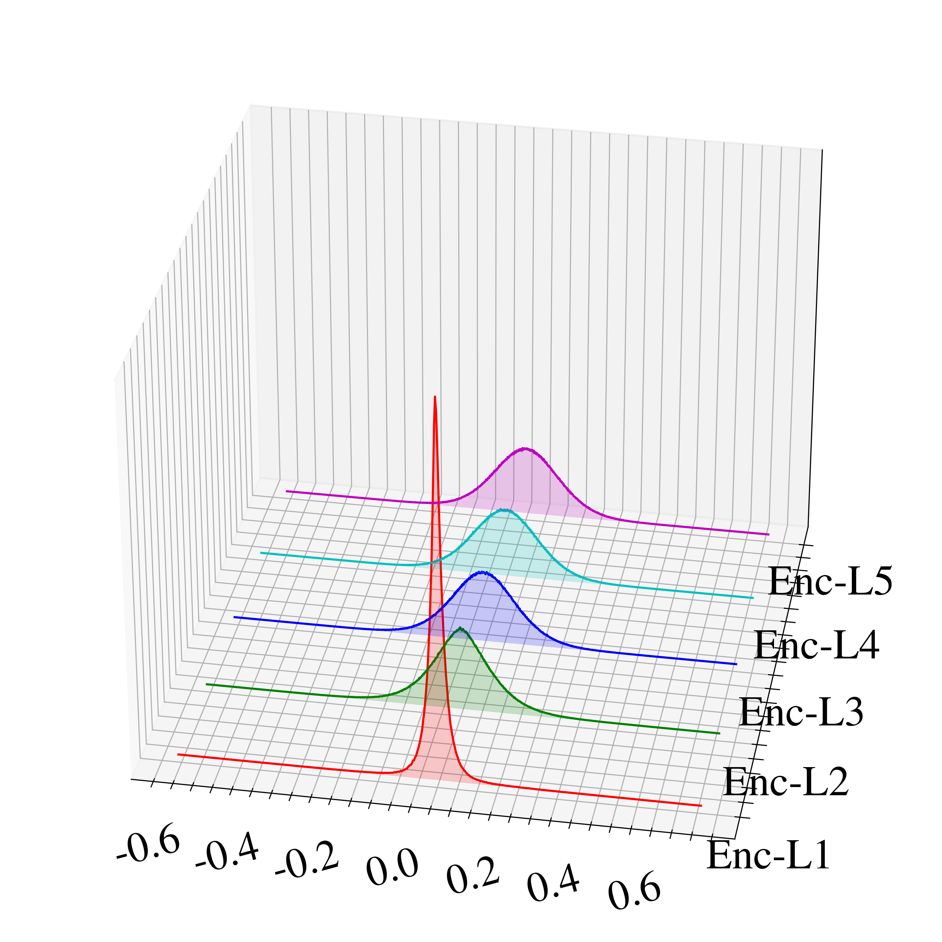
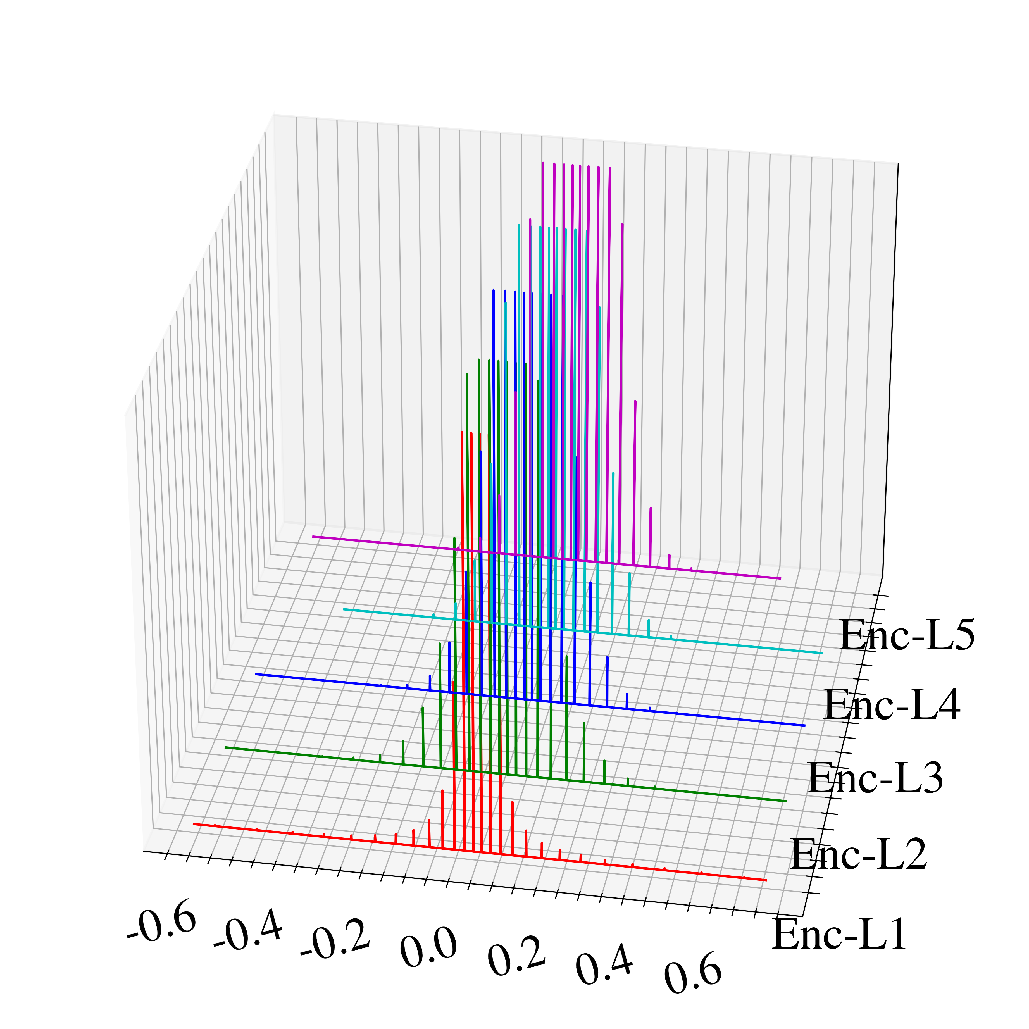
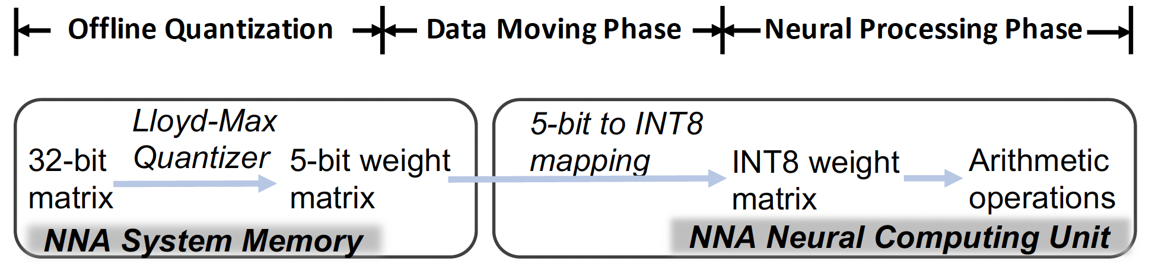
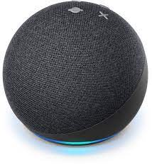
Conformer Quantization
Quantization-aware training (QAT) for on-device ASR
In 2021, 8-bit QAT was brought onto Laser/Theia.
In 2022, sub-8-bit QAT enabled model deployment to Brownie/Ganache across locales.
Why QAT is needed?
To make on-device speech processing faster with data in lower-bit representation
To preserve the accuracy as it prepares the model during training for runtime in terms of bit-depth
Training time
32-bit
5-bit
Runtime time

Slide 11
Conformer Quantization
Is QAT needed for cloud ASR?
Cloud ASR runtime also represents weights in 8-bit.
Weights are compiled to INT8 during packaging, while inputs are quantized on-the-fly.
QAT won’t lead to latency reduction: the model runs in INT8 mode.
QAT for cloud Conformer is more of an accuracy-driver.
FP32
FP32
FP32
FP32
INT8
Conformer training in Phasa
Serialization in Phasa
IL in Phasa
EB in Phasa
Packaging
In DBS
FP8
~FP8
~FP8
~FP8
Conformer training in Phasa
Serialization in Phasa
IL in Phasa
EB in Phasa

Slide 12
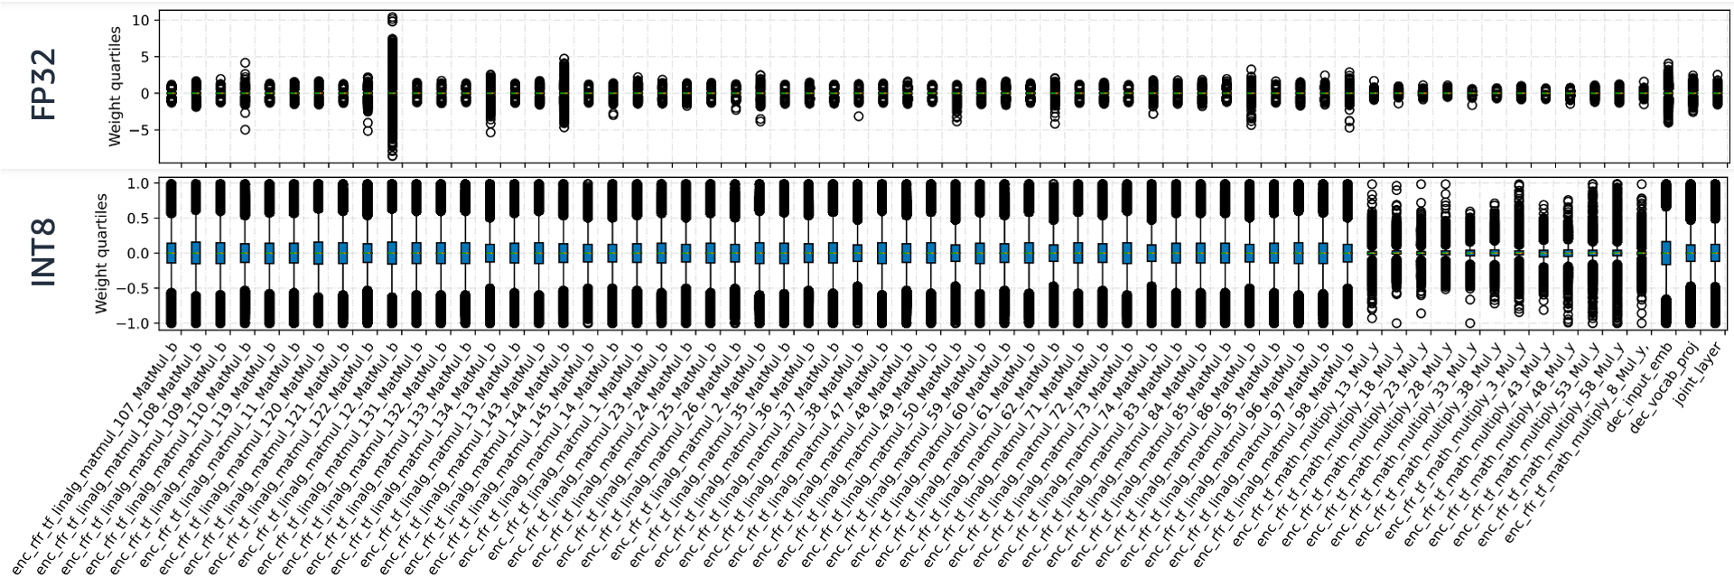
Conformer Quantization
8-bit post-training quantization is lossy
32-bit trained weight distributions vary among layers
Subject to clipping error and round error

Slide 13
Conformer Quantization
8-bit post-training quantization is lossy
How much accuracy loss exactly is from 8-bit PTQ?
FP32
FP32
FP32
FP32
INT8
Conformer training in Phasa
Serialization in Phasa
IL in Phasa
EB in Phasa
Packaging
In DBS
FP32
Packaging
In DBS
Test set | INT8 | FP32 | WERR (FP32 v.s. INT8)
tail_golden_live | 4.93 | 4.7 | 5
wbr | 7.69 | 7.63 | 1
system_multiturn_2022 | 10.22 | 10.15 | 1
https://blueflame-eu.aka.amazon.com/execution/00ae93c7-5b14-45bd-8fd4-b1ab5f690d56

Slide 14
Conformer Quantization
QAT+PTQ v.s. PTQ
With QAT, the de-DE Conformer candidate shows 2-4% WERR after NB on wbr/tail/multiturn.
Disabling both LM passes, we still observe 1-4% WERR.
Just 1% WERR?
Reclaimed from quantization-induced loss
Same model capacity
Test set | FP32->INT8 | ~FP8->INT8 | WERR
tail_selection | 7.56 | 7.5 | 1
wbr | 7.83 | 7.75 | 1
system_multiturn | 10.73 | 10.55 | 2
Test set | FP32->INT8 | ~FP8->INT8 | WERR
tail_selection | 7.41 | 7.18 | 3
wbr | 7.72 | 7.51 | 3
system_multiturn | 10.41 | 10.01 | 4
INT8
INT8
INT8
Packaging
In DBS
Packaging
In DBS
Packaging
In DBS
✓
✓
✓
FP8
~FP8
~FP8
~FP8
INT8
Conformer training in Phasa
Serialization in Phasa
IL in Phasa
EB in Phasa
Packaging
In DBS
✓
https://blueflame-eu.aka.amazon.com/execution/96c616a0-2a55-4cae-bdc8-d4b829b4d068
(LM disabled) https://blueflame-eu.aka.amazon.com/execution/3cbde29c-9c37-4607-8e61-a6bc93f5a312

Slide 15
Quick Overview of our Hardware Acceleration Plan
Priority for 2023 – Technologies Applicable to All Layers
Quantization
Conformer – prod Conformer, next step 1B
RescoreBERT – kickstarted together with Denis, presented later
Sparsification
Conformer – NemoRT support needed
RescoreBERT – good results obtained, presented later
LM team: Yile Gu, Jari Kolehmainen, Prashanth Gurunath Shivakumar
NeMoRT team: Chris Beauchene, Jane Chen
Embedding
8-bit quantization and sub-8-bit compression – on-hold as lacking HC

Slide 16
Sparse RescoreBERT
Similar to quantization, neural sparsity is “hardware specific”.
Accelerating column-wise / tile-wise sparse Conformer on CPU (need NeMoRT support)
Accelerating 2:4 sparse RescoreBERT/Conformer on GPU
Sparsity Pattern
Hardware Type
Acoustic Model
Language Model
Column/tile sparsity
NNA
Conformer
CPU
RescoreBERT
2:4 sparsity
GPU
: Short-term plan
: Long-term plan

Slide 17
Sparse RescoreBERT
Similar to quantization, neural sparsity is “hardware specific”.
Accelerating column-wise / tile-wise sparse Conformer on CPU (need NeMoRT support)
Accelerating 2:4 sparse RescoreBERT/Conformer on GPU
Sparsity Pattern
Hardware Type
Acoustic Model
Language Model
Column/tile sparsity
NNA
Conformer
CPU
RescoreBERT
2:4 sparsity
GPU
: Short-term plan
: Long-term plan

Slide 18
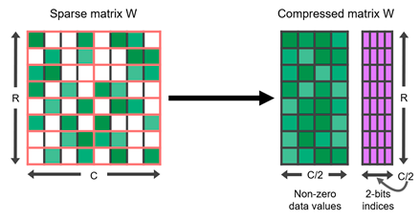
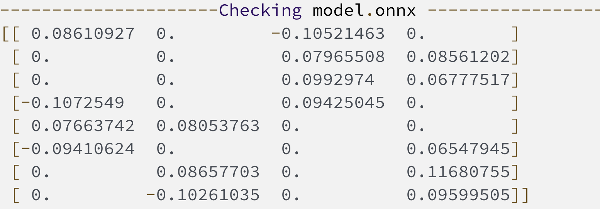
Sparse RescoreBERT
2:4 structured sparsity for g5
Sparse Tensor Cores accelerate a 2:4 sparsity pattern on NVIDIA A100 GPU
Such a regular pattern is easy to compress and has a low metadata overhead.
Up to 2x runtime speedup
Input Operands | Accumulator | Dense TOPS | Sparse TOPS
FP32 | FP32 | 19.5 | –
TF32 | FP32 | 156 | 312
FP16 | FP32 | 312 | 624
BF16 | FP32 | 312 | 624
FP16 | FP16 | 312 | 624
INT8 | INT32 | 624 | 1248
https://hanlab.mit.edu/files/course/slides/MIT-TinyML-Lec04-Pruning-II.pdf
https://developer.nvidia.com/blog/accelerating-inference-with-sparsity-using-ampere-and-tensorrt/

Slide 19
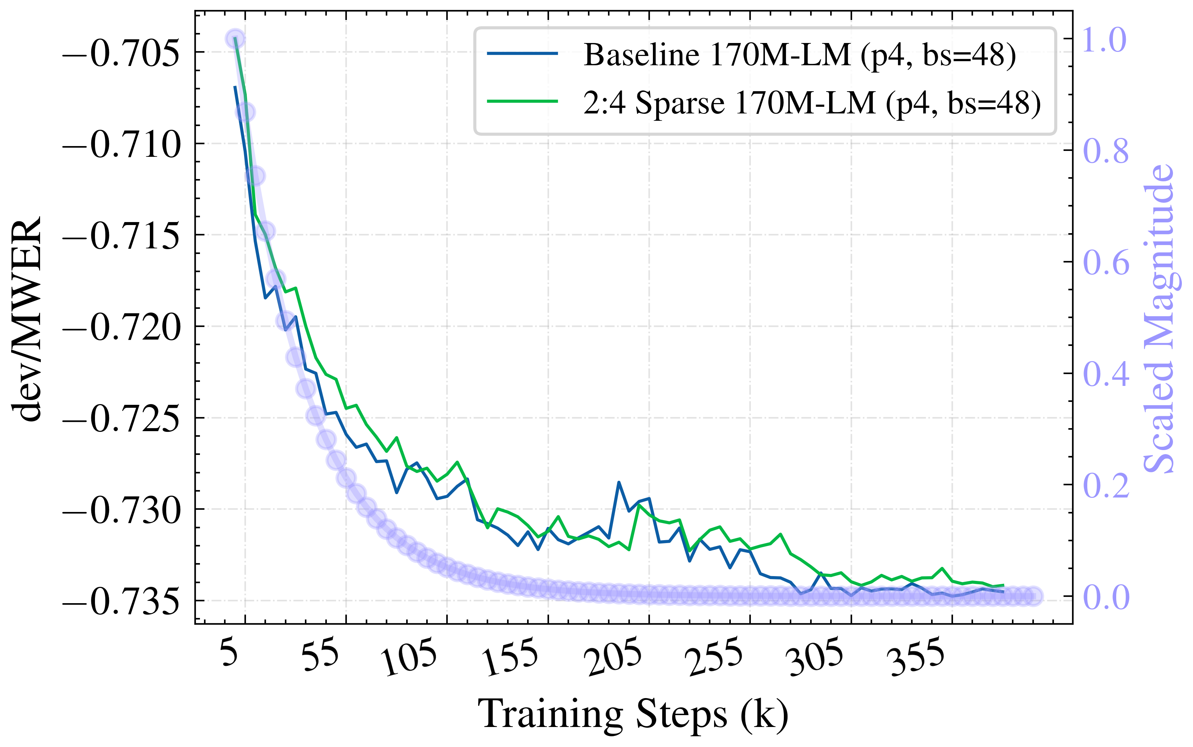
Sparse RescoreBERT
Accuracy
No degradation observed during training
In Bluebottle, w. sparse RescoreBERT
No degradation on glidepath
1% relative degradation on tail
Test set | Dense LM | Sparse LM | Rel. Deg.
glidepath | 8.39 | 8.41 | 0
Info_tail | 6.51 | 6.56 | 1
170M RescoreBERT | dev/WER | dev/MWER | dev/untuned_wer
Baseline | 0.13 | -0.73 | 11.61
50% sparsity | 0.13 | -0.73 | 11.62
glidepath: https://blueflame-na.aka.amazon.com/execution/3d9393a2-b687-4602-a427-487af4c88801
tail: https://blueflame-na.aka.amazon.com/execution/73f16167-cc7e-4cd4-aae6-3874bfb3a01f

Slide 20
Sparse RescoreBERT
What’s next?
Runtime support for sparse RescoreBERT acceleration
https://sim.amazon.com/issues/ASRCT-3927
Patch sparse 170M RescoreBERT into Bluebottle R19
Experiment with 1B RescoreBERT (post-training sparsification, etc)

Slide 21
Quick Overview of our Hardware Acceleration Plan
Priority for 2023 – Technologies Applicable to All Layers
Quantization
Conformer – prod Conformer, next step 1B
RescoreBERT – kickstarted together with Denis, presented later
Sparsification
Conformer – NemoRT support needed
RescoreBERT – good results obtained, presented later
Embedding
8-bit quantization and sub-8-bit compression – on-hold as lacking HC

Slide 22
LLM/RescoreBERT Quantization
Kickstart Meeting with YiGu, Denis, Shaun, Gautam, Chris, Bofeng, etc.
Bofeng preliminary results for naïve post-training quant
CPU FP32 output: [-8.2429 -13.1120 -5.8216 -9.7047 -10.4250 -4.6697 -4.7104]
GPU INT8 output: [0.06719 0.06719 0.067199 0.06719 0.06719 0.067199 0.067199]
Need Science assistance to test advanced post-training quant and quantization-aware finetuning
Timeline
Proof of Concept ready 08/15
Production ready: 09/01
Launch ready: 09/19
Science plan
Advanced post-training quantization: Smooth quant
Quantization-aware finetuning
Combination

Slide 23
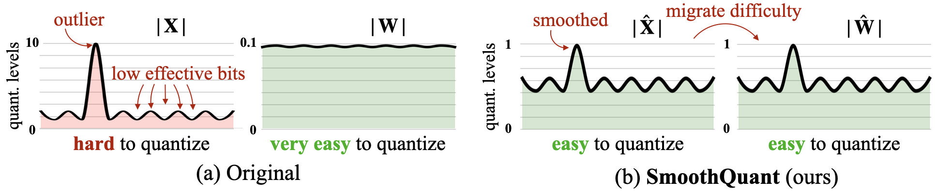
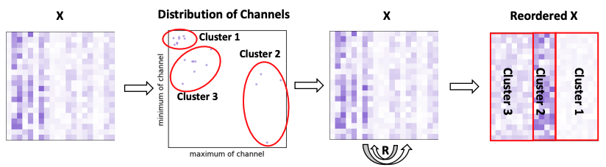
LLM Quantization: Post Training Quantization
Post training quantization
Smooth Quant
Reorder-based Quant

Slide 24
LMM Quantization
Smooth quant (first candidate)
Range of models : reported 125 M< x < 530 B
Quantization: W8A8 to W4A8
Quantization types: static
Dependencies: torch-int, CUTLASS INT8 GEMM kernels
Performance : 1.56× speedup and 2× memory reduction for with negligible loss in accuracy.
Risks: for small models (e.g. 1 B) may not demonstrate its performance
Challenges: calibration dataset
quantization parameters for activations and weights: minmax
Code: available
Neural Efficiency for LAM/LLM
Notes:
Issues with SQ: 1- high variance of value range across channels 2- issues with weight quantization. Per-vector scaled quantization (VSQ) may solve but expensive.

Slide 25
LMM Quantization
Reorder based quantization (second candidate)
Range of models : reported 1.3 B< x < 175 B
Quantization: W4A16 to W3A3
Quantization types: static
Dependencies: nothing specific identified.
Performance : for OPT-175b, memory usage can be reduced by 73% with a perplexity loss of less than 0.5
Risks: overhead of reorder operations
Challenges: calibration dataset
quantization parameters for activations and weights: minmax
Code: available
Neural Efficiency for LAM/LLM
Notes:
we quantize the activations within each cluster. Specifically, we calculate the quantization parameters (scale s and zero point z) individually for each cluster. As a result, channels with analogous maximum and minimum values are assembled together and share the same quantization parameters. This method guarantees optimization of the quantization process for every cluster, ultimately reducing the quantization error.

Slide 26
Quick Overview of our Hardware Acceleration Plan
Tentative Plan for 2024 – Technologies to Address Memory Constraint
Sub-8-bit weight
Weight sharing for LAM/RescoreBERT layers
Arbitrator turning layers on and off
Low-rank approximation of attention
Quantization Aware Finetuning (QAF)
LayerDrop and Distill

Slide 27
Quantization Aware Finetuning (QAF)
Step 1: Visualize and analyze the distribution of LMM weights/activations
We want to visualize the distribution of both the weights and activations, so that we will have better understanding of which techniques should we apply
Step 2: Quantization aware finetuning (QAF)
QAF on weights
Candidate method: Apply general quantizer and finetune the LMMs with regularizing the weights
QAF on activations
The range of activations for LLMs is usually quite large
We need implement techniques to narrow down the range and regularize the activations as well

Slide 28
Quick Overview of our Hardware Acceleration Plan
Tentative Plan for 2024 – Technologies to Address Memory Constraint
Sub-8-bit weight
Weight sharing for LAM/RescoreBERT layers
Arbitrator turning layers on and off
Low-rank approximation of attention
Quantization Aware Finetuning (QAF)
LayerDrop and Distill

Slide 29
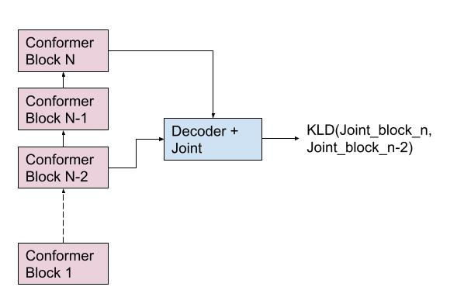
LayerDrop and Distill
In this method, the model learns to self-distill itself to lower layers.
During the core transducer training, we perform a forward pass through full conformer to compute `rnnt_loss_1` and a partial forward pass (output tapped from earlier layers) and compute `rnnt_loss_2`.
Additionally, we include a KL-divergence objective between the joint lattice probability distributions obtained through the full forward pass and the partial forward pass.

